Slide 1
XY Stitching and Z Alignment of the Liver Dataset
Ishaan Singh Chandok
Notes:
SOFIMA, primarily developed by Michal Januszewski, a researcher at Google
His research often focuses on applying machine learning tools to study the connectome of the drosophilia (fruit fly) connectome

Slide 2
Outline
Background on Liver Dataset and SOFIMA (Scalable Optical Flow-based Image Montaging and Alignment)
XY Stitching and Results
Z Alignment and Results

Slide 3
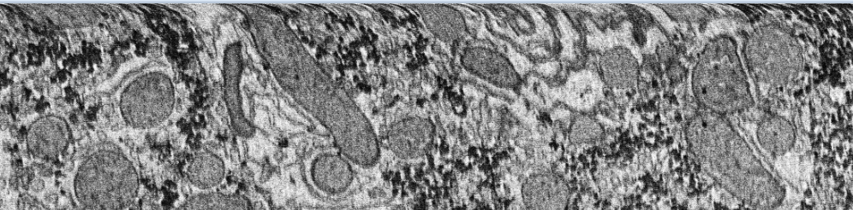
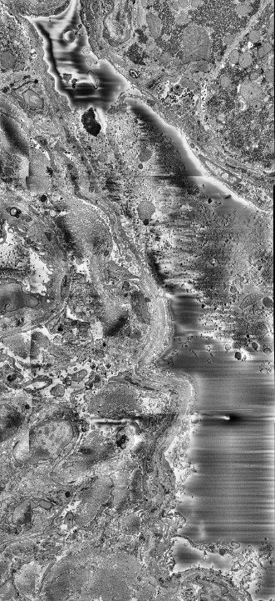
Properties of Liver Dataset
The human liver sections are imaged using a serial block-face scanning electron microscope (SBF-SEM)
CLAHE applied to improve contrast of raw images
Each tile has ideally ~10% overlap with neighbouring tiles, and each section is ~50 nm thick
Issues in the dataset include:
Warping at Edges
Charging
CLAHE = Contrast Limited Adaptive Histogram Equalization
Notes:
SB-SEM: The sections are cut in the SEM itself
Each image is 4000 x 4000 pixels
The charging was caused by resin being stuck in a blood vessel, and is present throughout the entire dataset
Unlike the heavy-metals used to stain the sample, resin is non-conducting, which causes this charging effect to occur
Unlike FIB-SEM (focused ion beam), the sections can be recovered and stored, allowing the sample to be re-imaged at a later date
Ideally, 10% overlap, but this number varies, and some sections do not overlap at all
Histogram Equalization
An image’s pixel values are confined to a certain range, which lies in a histogram
(Global) Histogram Equalization is basically stretching this histogram, allowing the pixels to span a wider range, improving the contrast of the image
However, performing a global operation like this might make some sections too dark or too bright
Adaptive Histogram Equalization makes this operation local by splitting the image into tiles and applying the operation within each tile (the tile grid size)
Contrast limiting prevents the histograms from becoming too large (the clip limit)

Slide 4
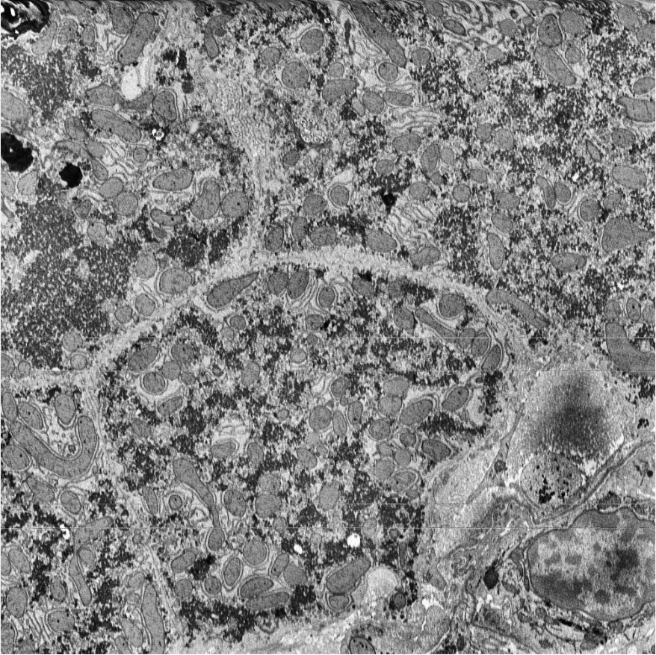
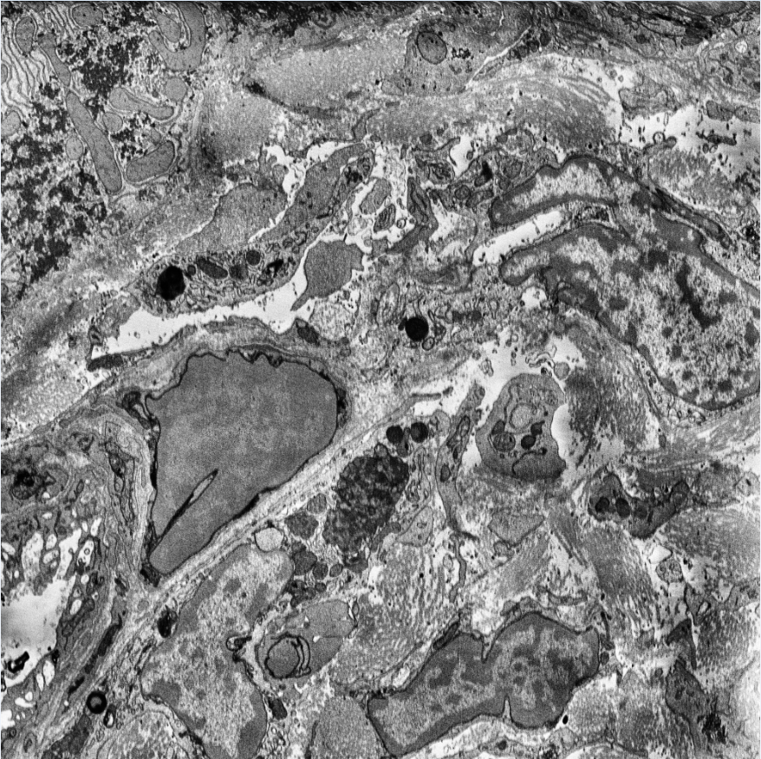
Top: Image 51, 16th Tile
Bottom: Image 51, 21st Tile
Low overlap and non-overlapping tiles
Notes:
It is nontrivial how much overlap is between these images
In coordinates, left = (3,1), right = (4,1), starting from (0,0)

Slide 5
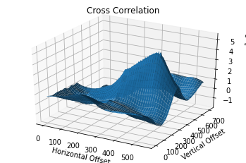
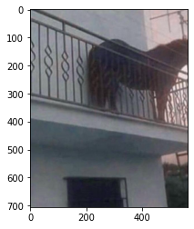
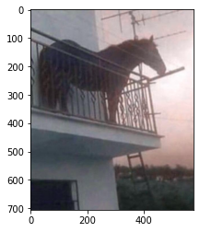
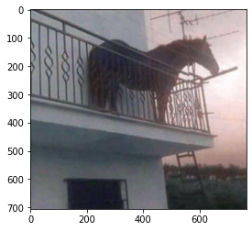
Cross-Correlation
SOFIMA relies on normalized cross-correlation to match images
Implemented using Fourier transforms
Global Peak: (353, 463), Peak for Y = 0: (191, 0).
Notes:
For 1D signals, cross-correlation measures the similarity of two signals as a function of their phase shift
The FT of cross-correlation of f and g is F(f) F(g)*, where * is complex conjugation
Suffices to flip one image by 180 degrees (equivalent to CC), fft both images, then take the inverse fft of their product
The issue with cross-correlation is that we need to provide additional information, such as a range of overlapping regions, or whether the motion is horizontal/vertical translation only
The global peak is not necessarily the correct translational offset between images
The horse is named Juan

Slide 6
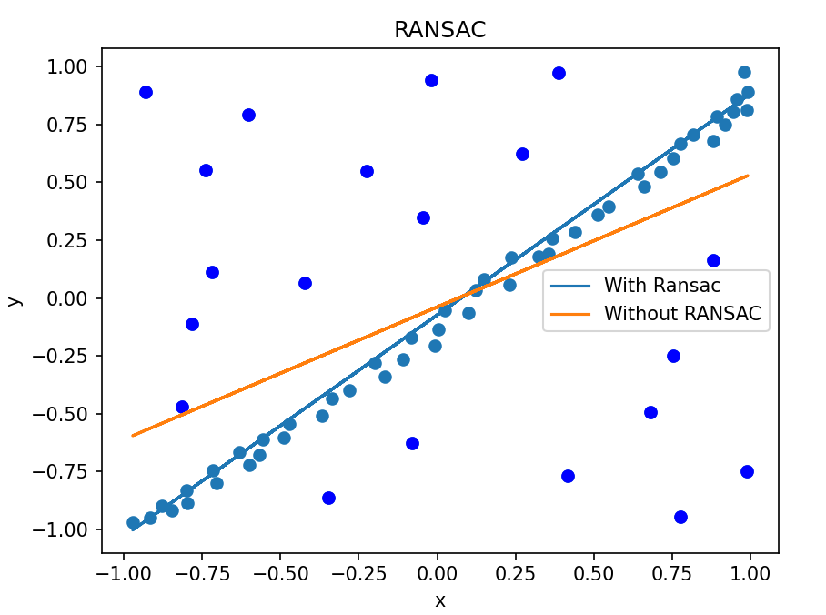
Scale Invariant Feature Transform (SIFT)
SIFT identifies scale and rotation invariant features in an image
Assigns a 128 dimension vector to each feature, called the descriptor
Finding an affine transformation between images amounts to matching descriptors and applying Random Sampling Consensus (RANSAC)

Slide 7
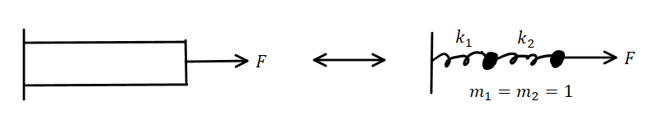
Spring-Mass System
Based on the analogous procedure in solid mechanics, where a solid is thought of as a spring-mass system
Either Newton’s laws or the energy method can be used to find the response of a spring-mass system
Ex: A cantilever’s response against an applied force

Slide 8
Overview of XY Stitching
Broadly, SOFIMA consists of a coarse alignment and a fine alignment step
In coarse alignment, the relative offsets are determined between images
In fine alignment, each image is meshed, and flows between mesh elements are computed
The mesh elements are treated as point masses in a spring-mass system, which is relaxed to determine their optimal position
Notes:
Coarse alignment followed by fine alignment step
Coarse alignment is analogous to Track EM2, where the translation between images is resolved
Fine alignment is analogous to Track EM2’s spring-mass system, where elastic stitching is done

Slide 9
Coarse Alignment

Slide 10
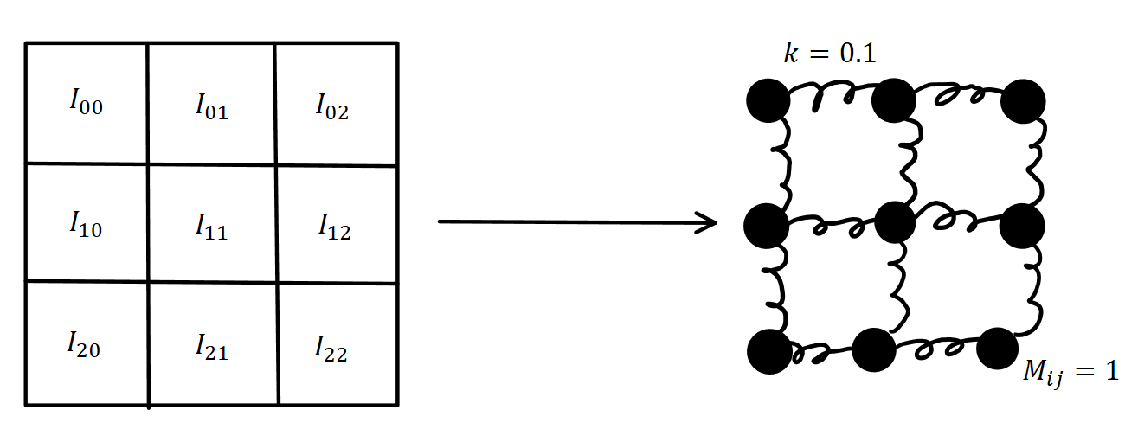
Find a coarse offset matrix between images. Relax this matrix using a spring-mass system.
The resting spring lengths are defined using the coarse offset matrices
Given the above initial conditions, Newton’s laws are solved via a time-stepping method to find the optimal relative offsets of the tiles
Notes:
A spring-mass system is set up with nearest neighbour connections
Each connection is a Hookean spring (obeys Hooke’s Law) with spring constant k = 0.1
The springs have resting length determined by the coarse offsets given by cx and cy
The initial state of the tiles is np.zeros_like(cx), i.e. their relative positions from being in a grid is 0
The system is evolved to find the position of the point masses/tiles at a later time (time-stepping method to solve Newton’s laws)

Slide 11
Fine Alignment

Slide 12
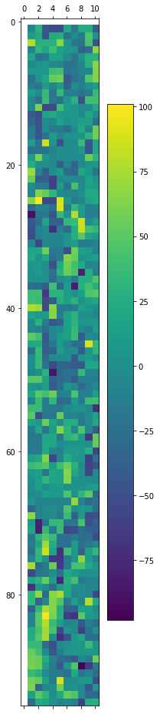
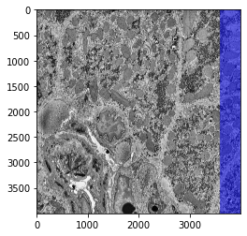
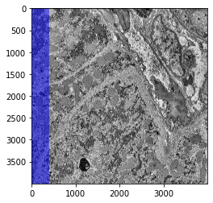
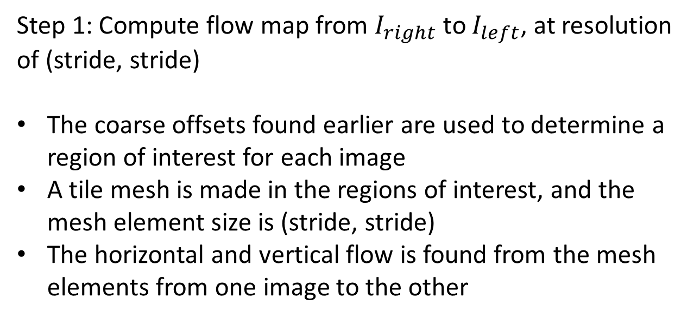
Step 1: Compute flow map from $I_{right}$ to $I_{left}$, at resolution of (stride, stride)
The coarse offsets found earlier are used to determine a region of interest for each image
A tile mesh is made in the regions of interest, and the mesh element size is (stride, stride)
The horizontal and vertical flow is found from the mesh elements from one image to the other
Flow from Right to Left, stride = 40
Left Image
Right Image
Notes:
Inputs are cx/cy, patch_size and stride
The coarse offset map is used to determine an ROI for each image, in this case the ROI is 400 pixels on the boundary of each image
The ROI is then “meshed” using a square grid
The stride/step determines how fine the mesh is, in this case, the mesh elements are (40,40) pixels each
A flow is computed from the mesh elements in one image to the mesh elements in the other image via cross-correlation
The patch size is the size of patches that are cross-correlated with each other, and they are cross-correlated at the resolution of the stride parameter
In this case, the flow is quite messy, likely because we underestimated the x-axis offset
The x-axis offset should be 600 – 700 px, not 400 px

Slide 13
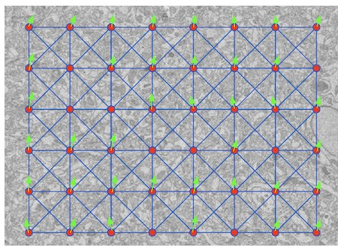
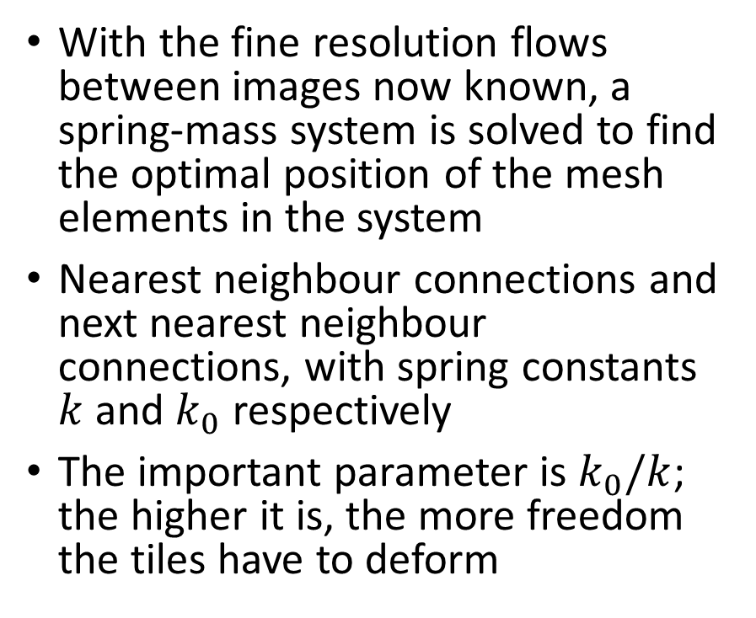
Step 2: Find optimal positions of tiles by solving a spring-mass system
With the fine resolution flows between images now known, a spring-mass system is solved to find the optimal position of the mesh elements in the system
Nearest neighbour connections and next nearest neighbour connections, with spring constants $k$ and $k_{0}$ respectively
The important parameter is $k_{0}/k$; the higher it is, the more freedom the tiles have to deform
Spring-Mass System, taken from [1]

Slide 14
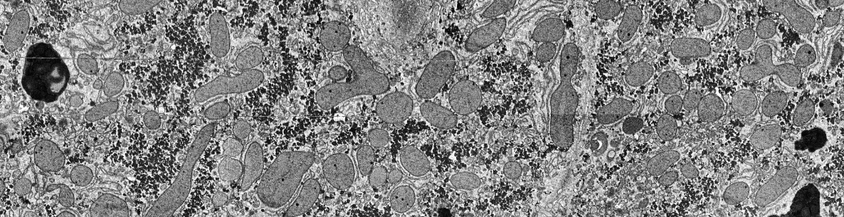
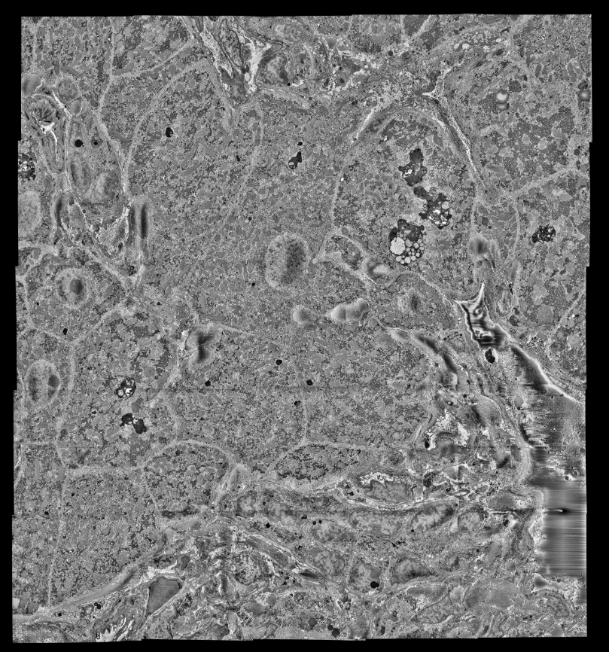
Results for XY Stitching
Algorithm for XY Alignment is run on Beluga Compute Canada Cluster with CUDA-enabled GPU acceleration
32 GB CPU and 16 GB GPU allocated
Runtime is ~10 min/section
Two configurations are attempted, if the first fails then the second is used
Issues such as lines in stitched image can be fixed in post-processing via normalize local contrast
Layer 0
Notes:
CONFIG1: ps = (120, 120), k0 = 0.01, stride = 20,
CONFIG2: ps = (40,40), k0 = 0.05, stride = 20,
Needed to reduce ps when config1 failed, likely because the estimated ROI between images was too small relative to the (120,120) ps
Stitched images are 20000 x 20000 pixels

Slide 15
Issues with XY Stitching
Underestimating coarse offsets

Slide 16
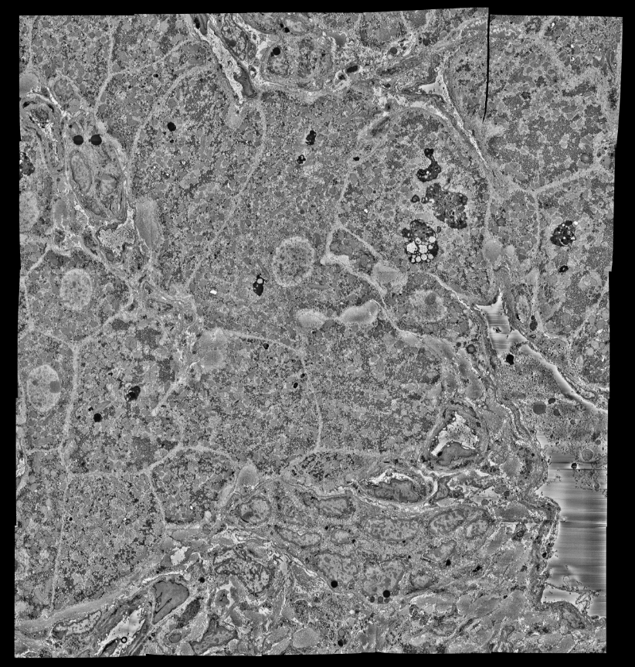
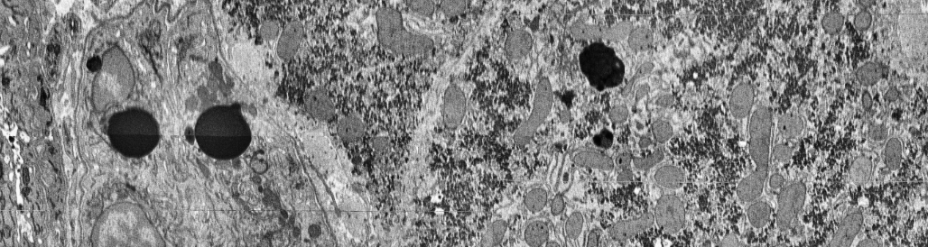
Issues with XY Stitching
Underestimating coarse offsets
Causes unaligned tiles
While the section is mostly well aligned, there is one tile that does not align at all
Layer 58

Slide 17
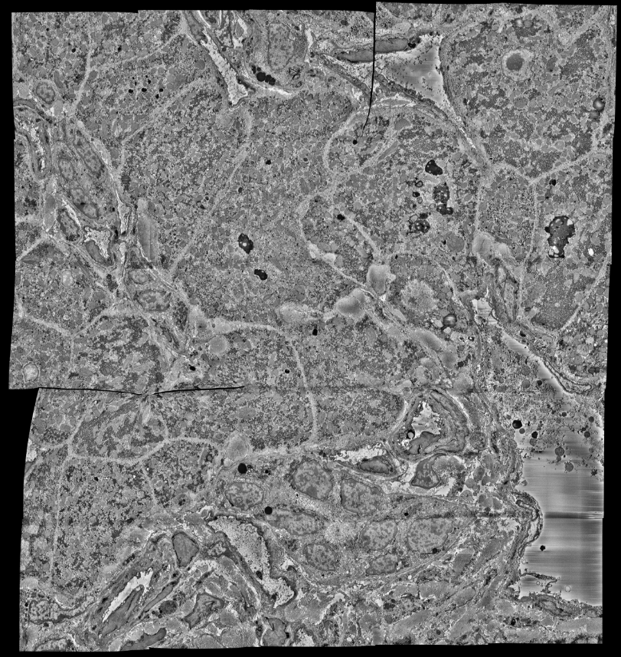
Issues with XY Stitching
Underestimating coarse offsets
Causes unaligned tiles
Results in excessive warping
Layer 97, Before

Slide 18
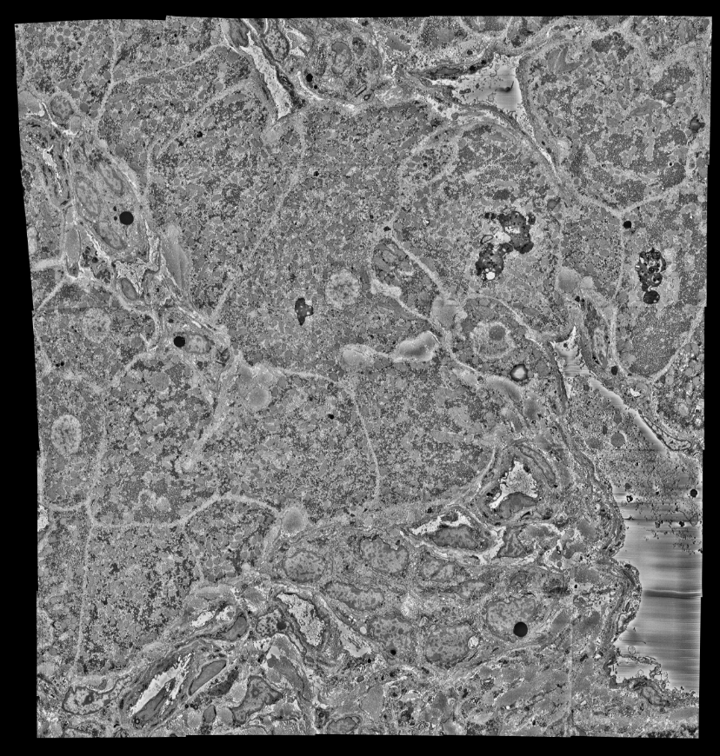
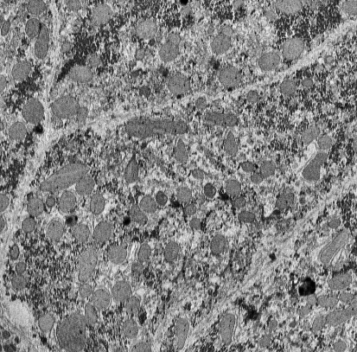
Issues with XY Stitching
Underestimating coarse offsets
Causes unaligned tiles
Results in excessive warping
As well, leads to “double vision”
Layer 78

Slide 19
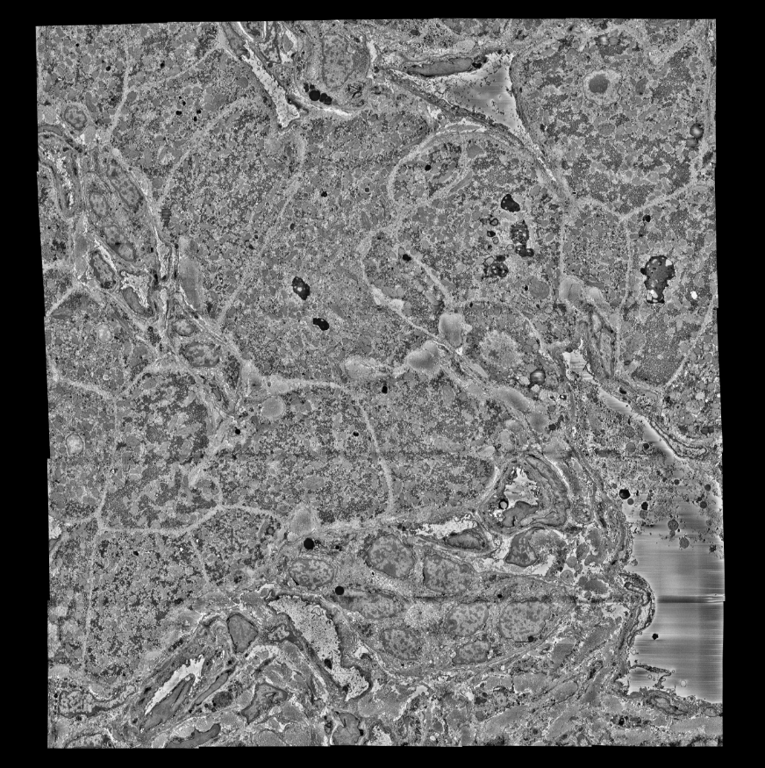
Issues with XY Stitching
Underestimating coarse offsets
Causes unaligned tiles
Results in excessive warping
As well, leads to “double vision”
Solved by deliberately overestimating coarse offsets and adding more redundancy to the offset calculation
Layer 97, After

Slide 20
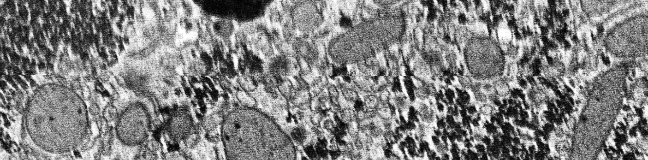
Issues with XY Stitching
Before, from Layer 21
Due to warping, which is mostly present at the top edge of images, fine alignment is tricky

Slide 21
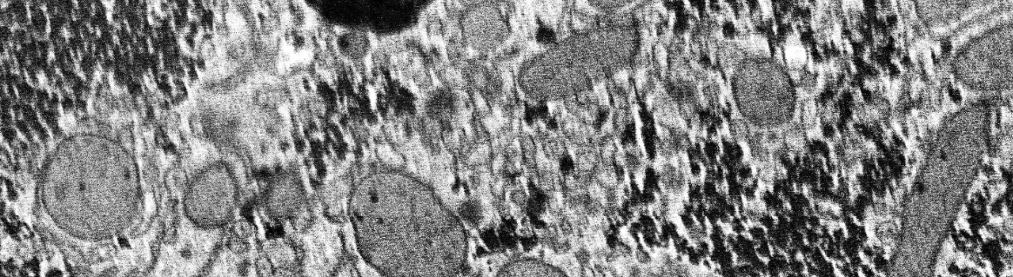
Issues with XY Stitching
Solved by rotating images 180 degrees before stitching
Notes:
Mention future improvements to prevent this problem
Triangular mesh
Increase mesh density at boundary of images

Slide 22
Z Alignment

Slide 23
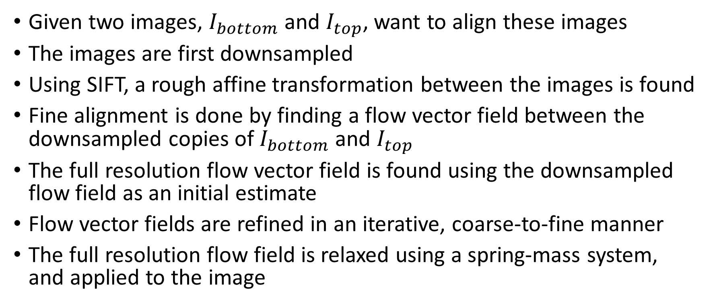
Overview of Z Alignment
Given two images, $I_{bottom}$ and $I_{top}$, want to align these images
The images are first downsampled
Using SIFT, a rough affine transformation between the images is found
Fine alignment is done by finding a flow vector field between the downsampled copies of $I_{bottom}$ and $I_{top}$
The full resolution flow vector field is found using the downsampled flow field as an initial estimate
Flow vector fields are refined in an iterative, coarse-to-fine manner
The full resolution flow field is relaxed using a spring-mass system, and applied to the image
Notes:
Technical Limitations of Z-Alignment
Images differ a lot
Cannot perform cross-correlations on large images without using lots of memory

Slide 24
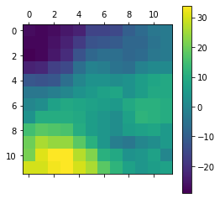
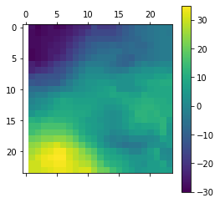
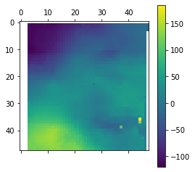
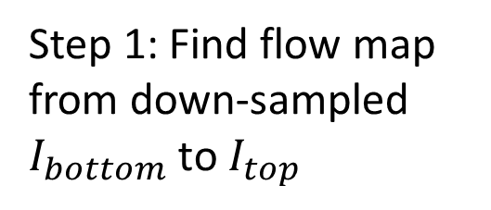
Computing Flow Map
Goal: Given $I_{bottom}$ and $I_{top}$, want to find a flow map between these images
Step 1: Find flow map from down-sampled $I_{bottom}$ to $I_{top}$
Step 2: Iterate until flow map has a fine resolution (filter intermediate maps)
Step 3: Estimate the flow map for the full resolution image
Notes:
Step 1: Flow map found from img2 to img1
The stride controls the resolution of the map, the patch_size controls the patches that are correlated and the batch_size controls parallelism
Step 2: Flow map is filtered
Step 3: A spring-mesh system smooths out the flow map
Without smoothing, applying a discontinuous flow would cause pixels to disappear in the actual image

Slide 25
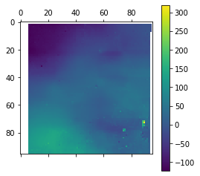

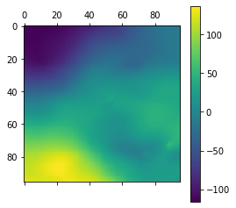
Computing Flow Map
Goal: Given $I_{bottom}$ and $I_{top}$, want to find a flow map between these images
Step 4: Iterate until full resolution flow map is sufficiently fine
Step 5: Filter the flow map for inconsistent values
Step 6: Use a spring-mass system to relax the flow map
Notes:
Step 1: Flow map found from img2 to img1
The stride controls the resolution of the map, the patch_size controls the patches that are correlated and the batch_size controls parallelism
Step 2: Flow map is filtered
Step 3: A spring-mesh system smooths out the flow map
Without smoothing, applying a discontinuous flow would cause pixels to disappear in the actual image

Slide 26
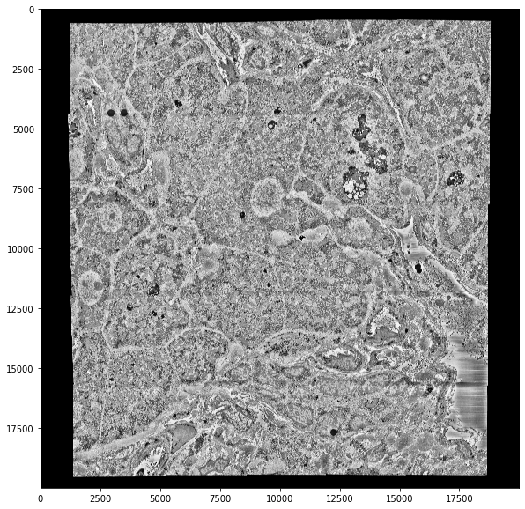
Layer 50, Before

Slide 27
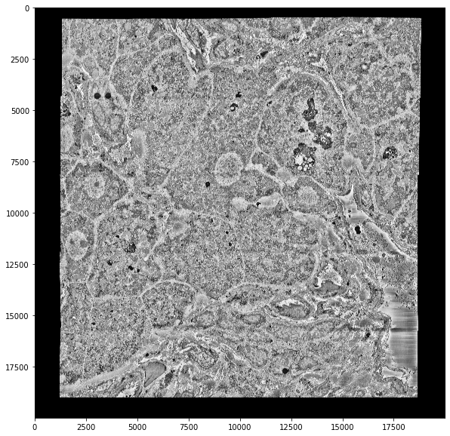
Layer 50, After

Slide 28
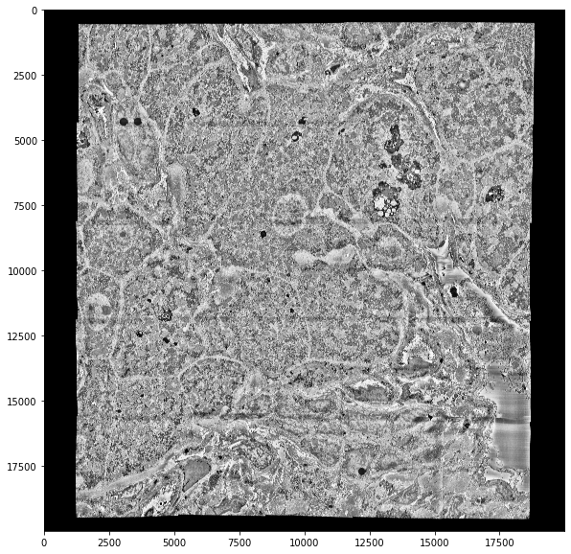
Layer 51

Slide 29
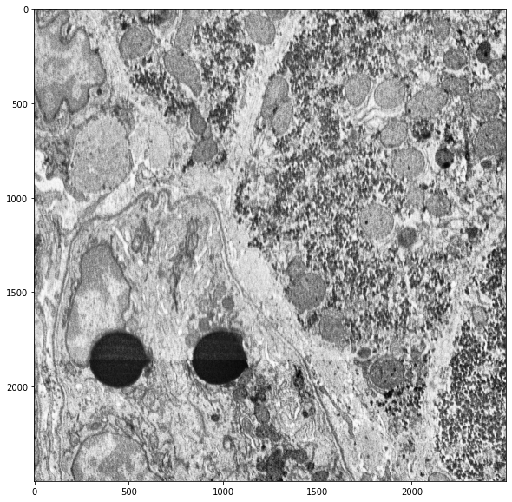
Layer 50, Before

Slide 30
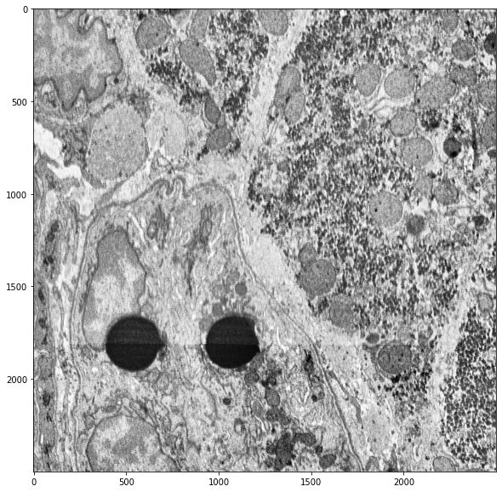
Layer 50, After

Slide 31
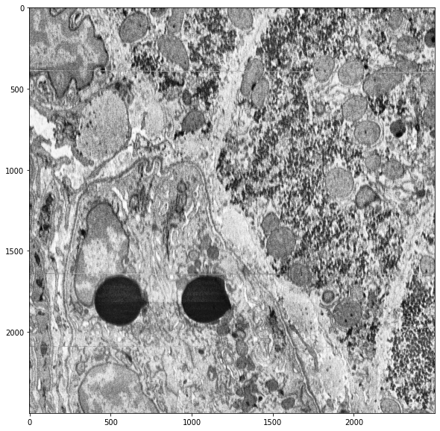
Layer 51

Slide 32
Possible Improvements
Need better flow filtering (local RANSAC)
Figure out why some pixels are missing
Use a smaller mesh size (increasing the resolution of flow maps also increases the noise, making it necessary to filter incorrect flows)
When aligning images, consider the flow with images further away to limit the propagation of alignment errors and prevent drift

Slide 33
Resources
[1] https://github.com/google-research/sofima

Slide 34
Acknowledgements
Zhen Lab
Prof. Mei Zhen
Dr. Ben Mulcahy
Dr. Tosif Ahamed
Dylan Fong
All members of Zhen Lab
Lichtman Lab
Dr. Yuelong Wu
Bader Lab
Ronald Xie

